Slide 1

Case study on Second hand car price prediction
Presented By:
1.Revu hari babu
2.Bala kottireddy
3.Krishnamsetty gamya sri
4.Padala subrahmanyam
5.Satish
6.Madasu vinay kumar
7.M mohan
Under The Guidance Of
GAURAV SINGH
Senior Faculty Data Science

Slide 2

Business Objective, Understanding And Approach
Business Objective, Understanding
Business objective
Business Objective
Understanding
Business Objective
Understanding
The business objective is to analyse the given data provided by the client and to design a linear regression trading algorithm to predict the best price of a used car based on its current condition.
Understanding of the problem
We have been assigned the task to build for the company a Linear Regression Machine Learning model which will assess the reselling value of a used car based on different features
Approach
Approach
Approach
We have to clean the given data set .
We have to do the feature engineering .
We have to do the model’s performance

Slide 3
Extended Data Dictionary (EDD)
Variable Name | mean | std | min | 1% | 5% | 25% | 50% | 75% | 95% | 99% | max | Missing Values %
selling_price | 5.174 | 5.203 | 2.999 | 5 | 1 | 2.5 | 4 | 6 | 1.2 | 2.7 | 1 | 0
km_driven | 7.400 | 5.836 | 1 | 5 | 1.2 | 4 | 7 | 1 | 1.5 | 2.38 | 2.36 | 0
fuel | 0.479 | 0.556 | 0 | 0 | 0 | 0 | 0 | 1 | 1 | 2 | 3 | 0
seller_type | 0.102 | 0.303 | 0 | 0 | 0 | 0 | 0 | 0 | 1 | 1 | 1 | 0
transmission | 0.084 | 0.278 | 0 | 0 | 0 | 0 | 0 | 0 | 1 | 1 | 1 | 0
owner | 1.513 | 0.743 | 0 | 1 | 1 | 1 | 1 | 2 | 3 | 4 | 4 | 0
seats | 5.433 | 0.969 | 2 | 4 | 5 | 5 | 5 | 5 | 7 | 9 | 14 | 2.7
mileage_in_ kmpl | 19.57 | 4.217 | 0 | 11 | 12.9 | 17 | 19 | 22 | 25 | 28 | 46 | 2.7
engine_ capacity_cc | 1431 | 485.9 | 624 | 796 | 796 | 1197 | 1248 | 1498 | 2499 | 2956 | 3604 | 2.7
max_power_ bhp | 87.86 | 31.31 | 0 | 37 | 47.3 | 68 | 81 | 99 | 147 | 190 | 400 | 2.6
car_years | 8.583 | 4.080 | 2 | 3 | 3 | 5 | 8 | 11 | 16 | 21 | 39 | 0

Slide 4
Findings from extended data dictionary
The average engine capacity in cc is 1431
The average kilometers driven by cars are 7.4 kms
2.7 % of values in mileage_in_kmpl , seats , engine_capacity_cc and 2.6% values in max_power_bhp variables was missed
Feature Engineering – New variables created
Sr. No | Variable Name | Variable Type | Description
1 | car_years | Integer | The total number of years since the car bought (age).

Slide 5
Data cleaning
Effected variable(s) :
The variables mileage , engine , and max_power are read in incorrect formate as object. It is converted into numerical type as float
Missing Values :
The missing values in mileage ,engine , max_power are replaced with mean and in seats are replaced with mode
Duplicate Records :
There are 15% duplicated records in the given data set and the duplicated recoreds are droped

Slide 6
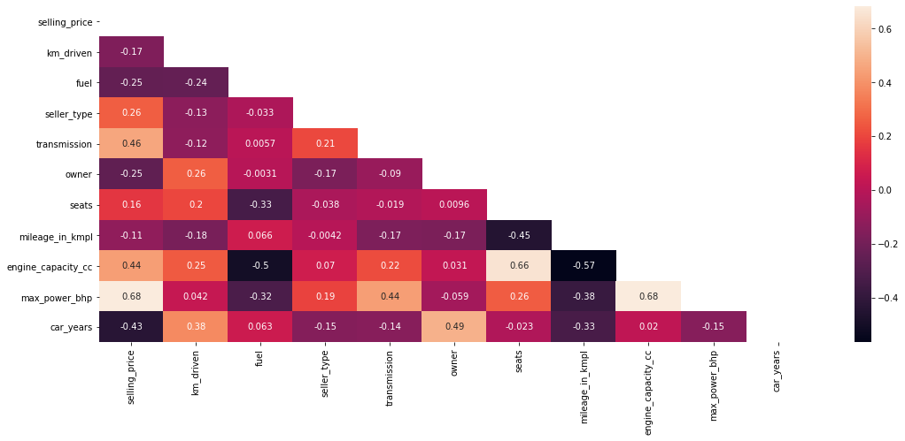
correlation of all independent variables
correlation of all independent variables

Slide 7
From correlation of all independent variables :
The variables has more correlation are :
Max_power_bhp and selling_price
Max_power_bhp and engine_capacity
Car_years and selling_price
Engine_capacity and mileage_kmpl
Outliers :
Varibles | max_power_bhp | km_driven | mileage_in_kmpl | engine_capacity_cc | car_years | selling_price
maximum | 192 | 280000 | 38.28 | 2401 | 29 | 1788000

Slide 8
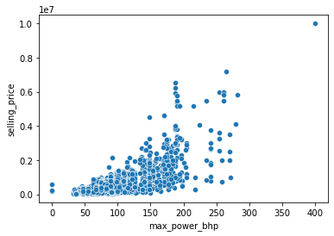
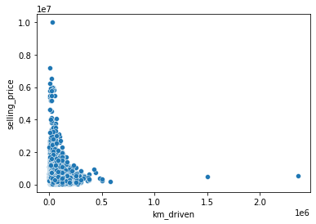
If the km_driven increases then the selling_price decreases
If max_power increases the selling_price also increase

Slide 9
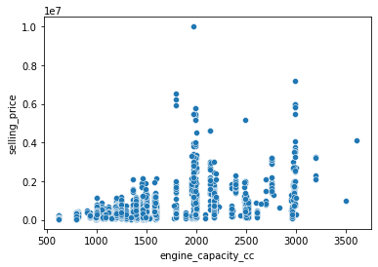
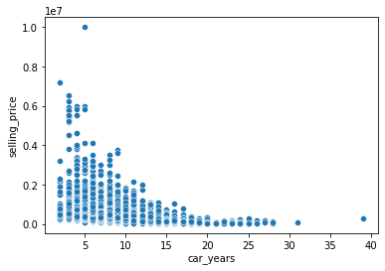
If engine_capacity increases the selling_price also increase
If car_price increases then the selling_price decreasses

Slide 10
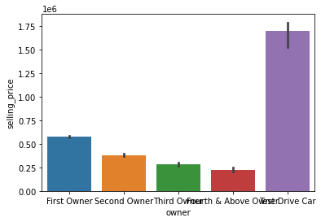
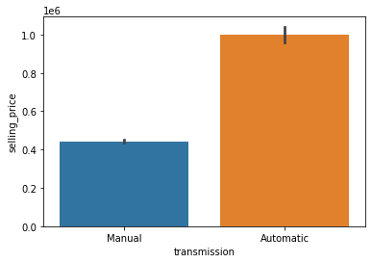
Test Drive cars have more selling price
Automatic transmission cars have more selling price compare to manual transmission cars

Slide 11
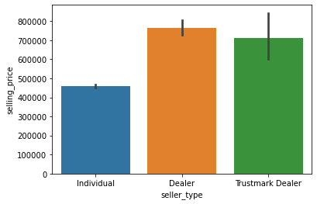
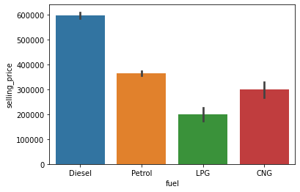
The cars sold by dealer have more selling price
The diesel type fuel cars have more selling price compare to other type

Slide 12
Model Creation
Firstly we split the data into two as training data and testing data to know the working of algorithm
Then we train the data with the required algorithm based on the target
ALGORITHM USED:
Algorithm used :
Linear regression is used .
Why we use this algorithm ?
From the business problem we see that the variables are the continuous varibles.

Slide 13
Model building and evaluation :
After completing all the pre processing steps we would be able to build the model
For building the model firstly we divided the dataset into 80% for training and 20% for testing the model
After that we choose our algorithm from the sklearn
Later we fit training data to our model
Finally we test the data

Slide 14
Slope values of features are :
selling_price : -9.27
km_driven : -6.94
Fuel : -6.70
seller_type : 2.28
transmission : -2.03
owner : -1.65
Seats : 7.75
mileage_in_kmpl : 1.55
engine_capacity_cc : 4.94
max_power_bhp :-3.34
Errors :
Mean absolute error :128742.8
Mean square error :31706046368.7
Accuracy : 0.75

Slide 15


